Slide 1

Airbnb Analysis:
France vs. Seattle
A comprehensive data-driven comparison of two distinct markets, examining host performance, pricing dynamics, and strategic opportunities across vastly different scales.
Name : S A Hari Ganesh
Enrollment No.: EN12025087784
Batch Code : DA524S52
Mentor : Vinoth

Slide 2











Project Objectives: Comprehensive Airbnb Market Analysis
Listing & Host Performance
Geospatial & Location Analysis
Customer Experience & Satisfaction
Evaluate host efficiency and listing dominance
Identify high-value "Premium Zones" and map customer satisfaction
Analyze demand patterns based on host behavior and identify the service standards
Properties & Amenities Analysis
Host Behavior Patterns
Demand & Seasonality Trends
Quantify the ROI of specific facilities, measuring the price premium generated by amenities
Contrast the operational strategies of multi-listing professional hosts
Track host onboarding cycles and identify peak booking months to optimize Hosts.
Risk Mitigation (Policy Analysis)
Machine Learning Predictive Modeling
Strategic Recommendations
Evaluate the impact of Cancellation Policies and Security Deposits on booking volume and host revenue protection.
Deploy advanced algorithms (KNN and Regression) for classifying room types and forecasting listing
Provide actionable, real-time insights for hosts to improve competitiveness in their specific local markets.
Final Conclusion (Best of Best)
Determine which market holds the upper hand in terms of scale versus service quality through a final comparative conclusion.

Slide 3


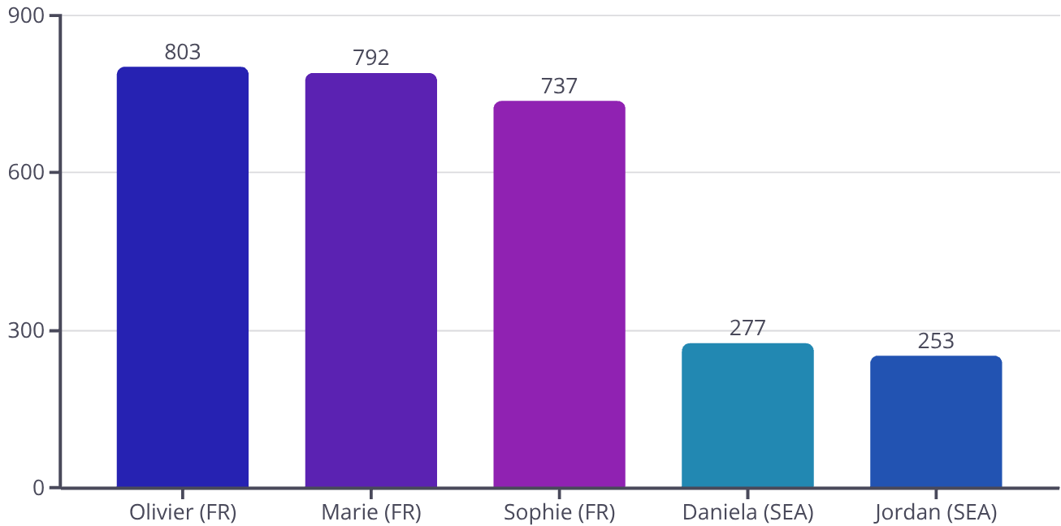
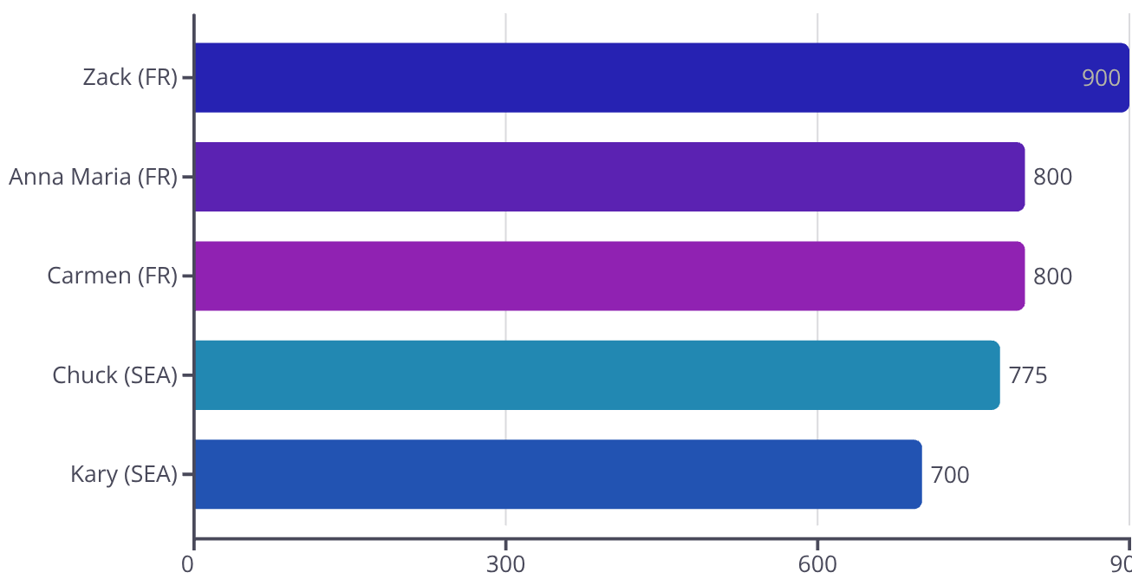
Listing & Host Performance Analysis
Market Characteristics
Key Insights
Metric
France
Seattle
France: Red Ocean
Total Listings
56,462
3,818
Dominated by large-scale professional agencies with significant portfolios.
Total Hosts
9,658
1,466
Top Host Volume
803 (Olivier)
277 (Daniela)
Seattle: Community Focus
Multi-Listing Ratio
22%
15%
More accessible market with individual hosts prioritizing quality over volume.
Top Host By Listing Count
Top Host by Avg Price ( Premium Host )

Slide 4






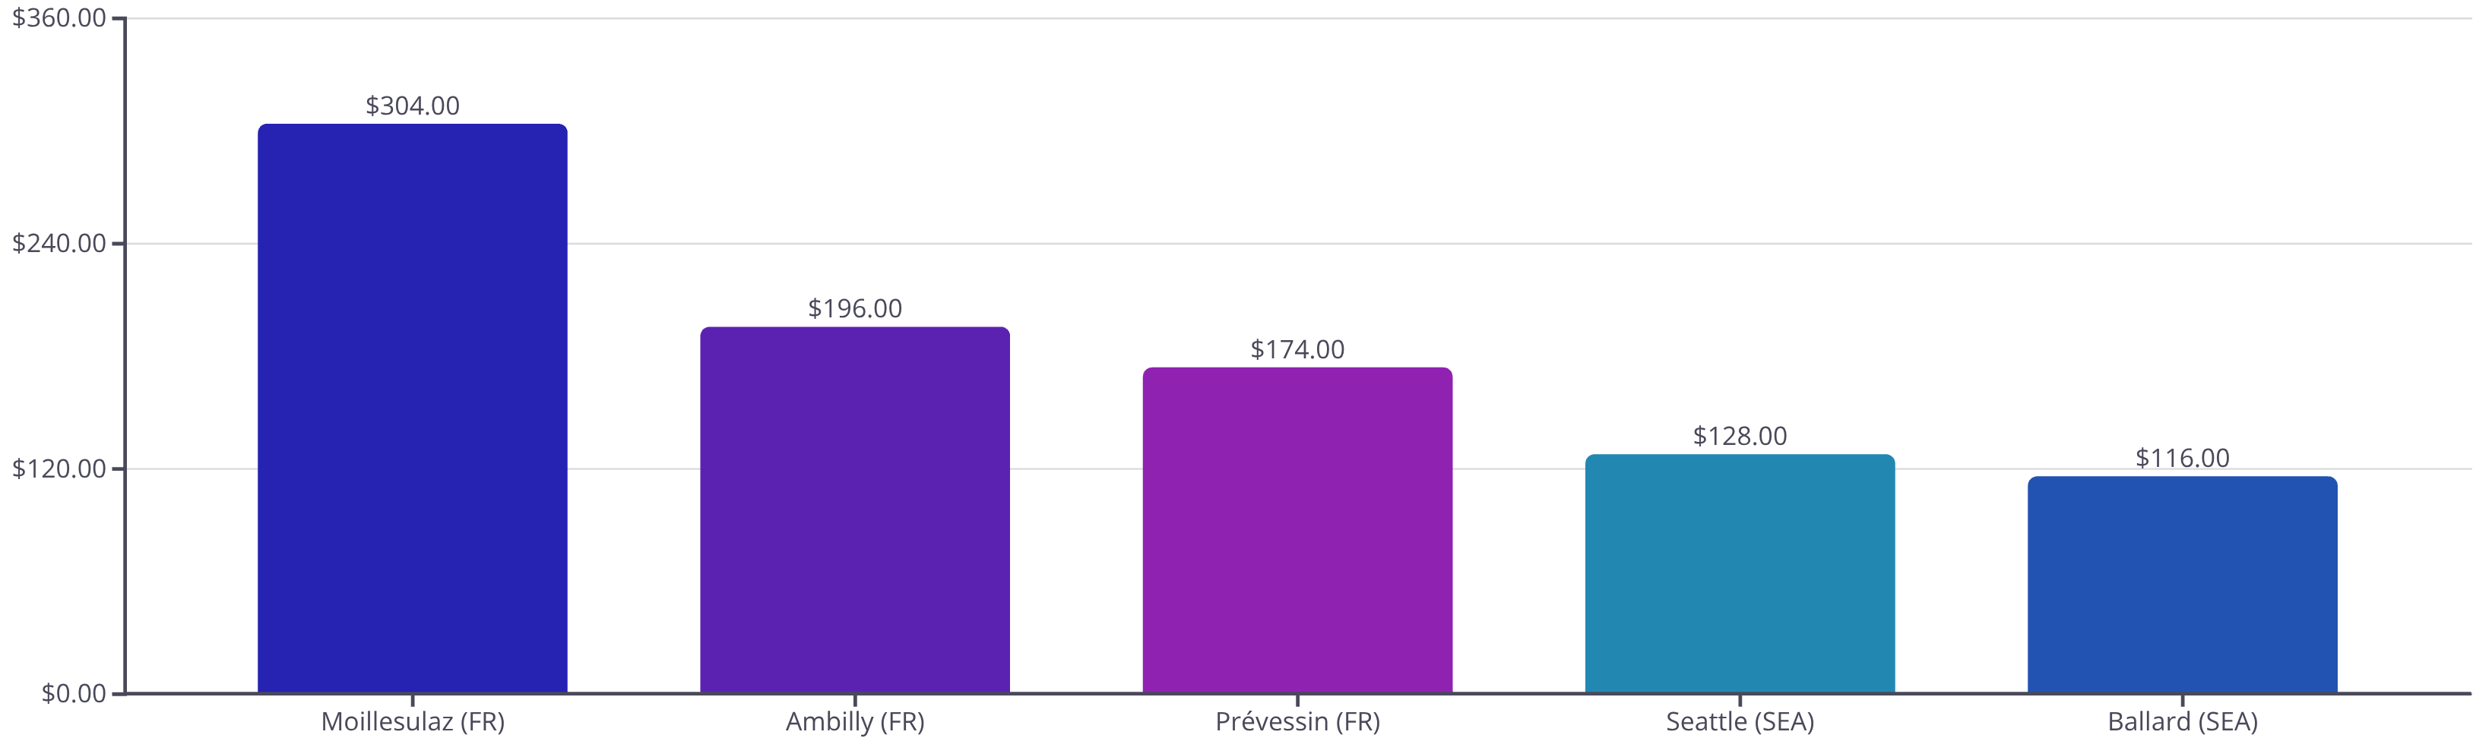
Geospatial and Location Analysis
Premium Zones
Value Zones
Guest Volume
France: Moillesulaz (€304)
France: Saint-Denis (€142)
France: 78,202 total
Seattle: Seattle ($128)
Seattle: Ballard ($116)
Seattle: 6,386 total

Slide 5



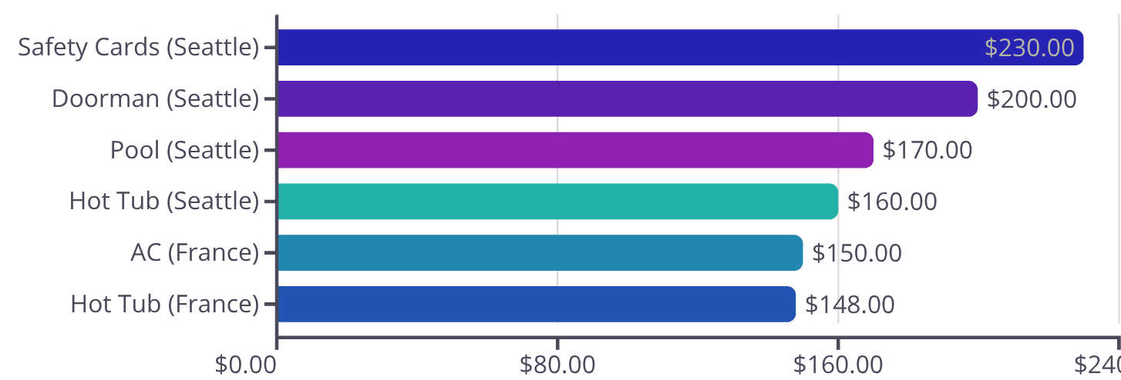
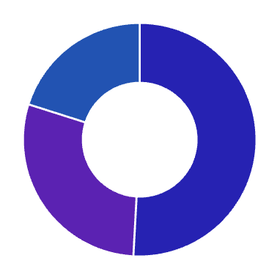
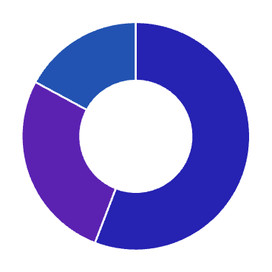
Properties and Amenities Analysis
Feature
France
Seattle
Key Property
Apartments (41k+)
Houses & Apartments (3.4K+)
Price Booster
AC (+€150)
Safety Cards(+$ 230)
Tech Standard
Basic Heating/Wi-Fi
High-speed (95%), Doorman, Pools & Hot Tub
France: Luxury AC
Seattle: Amenity Dominator
Universal Family Appeal
Air conditioning adds €150 premium—a key factor in urban apartments
Providing Safety Cards, Doorman Service and Swimming Pool Facilities to Customers
Kitchen facilities and cribs emerge as top revenue drivers across both markets.
France Room Type by Avg Price
Seattle Room Type By Avg Price
Entire Home/ Apt
Entire Room / Apt
Private Rooms
Private Rooms
Shared Rooms
Shared Rooms

Slide 6
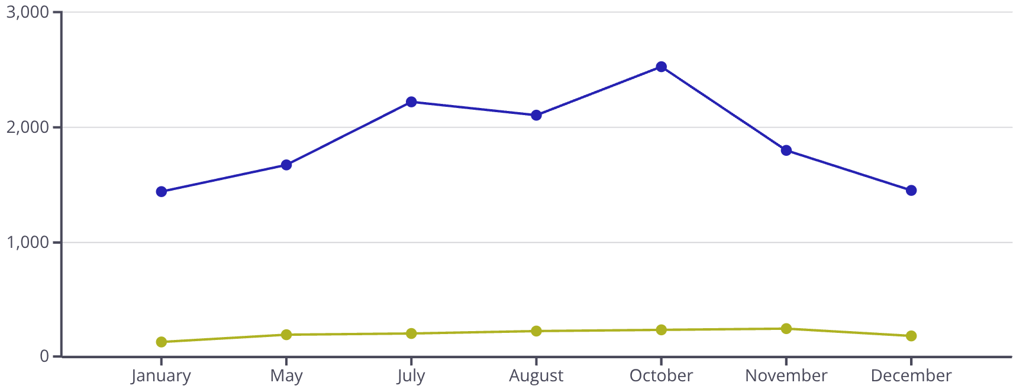
Demand and Seasonal Trends
Q1: Strategic Planning
Q3: Summer Demand
Hosts begin onboarding preparation for summer season in both markets.
July-August peak for both markets; Seattle onboarding continues.
1
2
3
4
Q2: France Peak Onboarding
Q4: Year-Round Stability
May surge as hosts position for 45+ day advance bookings.
Seattle maintains business travel; France shows seasonal decline.
Booking Behavior
Host Growth Over the Years
Pattern
France
Seattle
Peak Onboarding
May
August
Booking Window
45+ Days
~28 Days
Growth Spike
2014-2015
Steady 2015+
France New Hosts
Seattle New Hosts

Slide 7


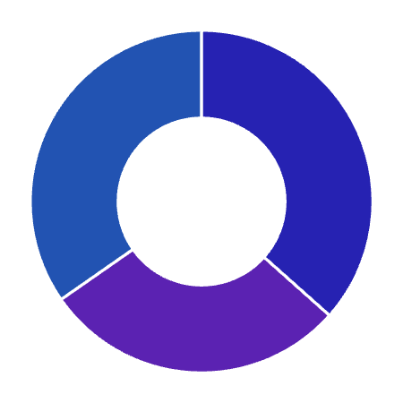
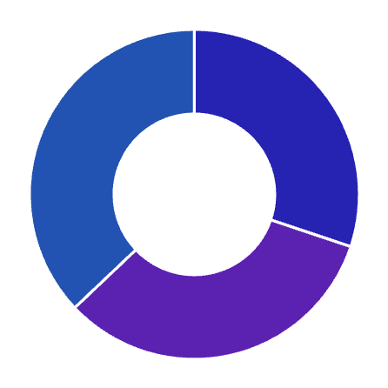


Cancellation Policies & Security Deposits
France: Cancellation Policy Distribution
Seattle: Cancellation Policy Distribution
Flexible
Flexible
Moderate
Moderate
Strict
Strict
Security Deposit Analysis
France
Security Metric
France
Seattle
High deposits coupled with flexible cancellation policies offer a safety net for hosts while accommodating high guest volume and last-minute changes.
Avg. Security Deposit
€180.78
$140.57
Strict CP (Avg)
€115.20
$154.60
Seattle
Flexible CP (Avg)
€81.10
$109.53
Lower deposits but stricter cancellation terms reflect a market prioritizing guest commitment and revenue stability.
Moderate CP (Avg)
€86.05
$114.77

Slide 8

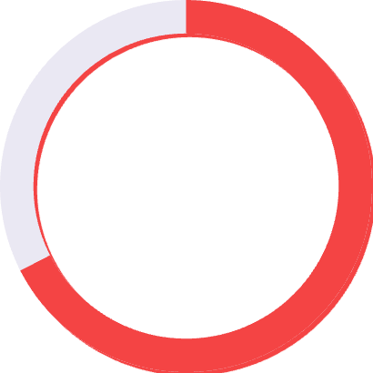


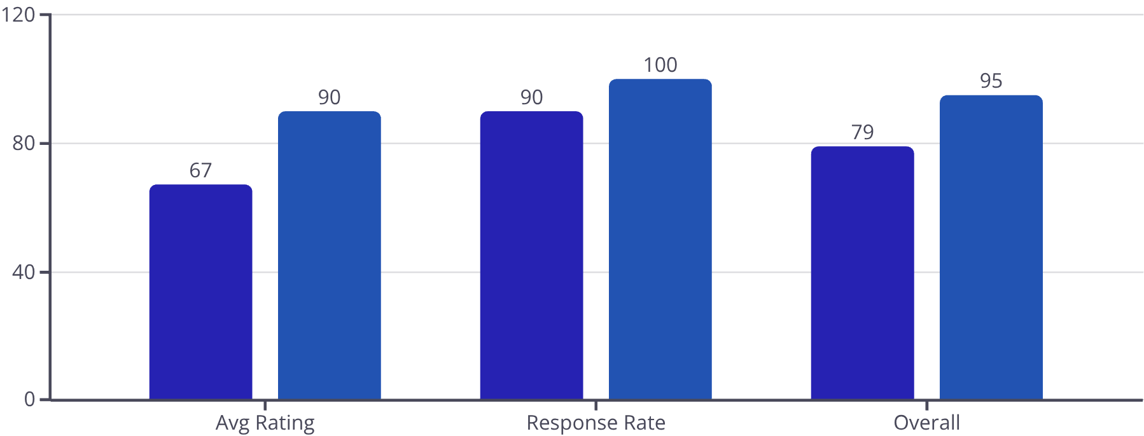
Customer Experience and Satisfaction
90.56%
67.51%
100%
90.39%
Avg Seattle Rating
Avg France Rating
Seattle Host Rate
France Host Rate
Service Benchmarks
KPI
France
Seattle
Avg Rating Scores
67.51 %
90.56 %
Host Response Rate
90.39 %
100 %
Cleaning Fee
€21.43
$43.72
France %
Seattle %

Slide 9



Statistical Hypothesis Testing
1
2
Host Growth Analysis
Amenity Vs Room Type Analysis
Test: Z-Test
Test: T-Test
France: Reject H₀ (z=3.95, p<0.001)
France: Reject H₀ (p<0.05)
Seattle: Reject H₀ (z=3.21, p<0.001)
Seattle: Reject H₀ (p<0.05)
3
4
Review Volume Expansion
Host Rate Analysis
Test: Z-Test
Test: Z-Test
France: Failed to Reject H₀
France: Reject H₀
Seattle: Reject H₀
Seattle: Reject H₀
Statistical Significance: All tests demonstrate p-values below 0.05 threshold, providing 95% confidence that observed market growth.
These findings validate strategic investment decisions in both markets.

Slide 10





Machine Learning Predictive Modeling
Analysis
Room Type Analysis
Room Type Analysis
Reviews Analysis
Property Analysis
Customer Analysis
ML Model
France
Seattle
KNN (Accuracy)
89.0%
85.7%
Logistic Regression
87.5%
84.8%
K-Means Clustering
4 Clusters
3 Clusters
Multi-Linear (R²)
0.44
0.53
Simple Linear (R²)
0.29
0.42
Logistic Regression
France (87.5%) | Seattle (84.8%).
Multi-Linear
K-Nearest
Neighbors (Winner)
Regression
France (R²=0.44) | Seattle (R²=0.53).
France (89%) | Seattle (85.7%).
3
2
4
Simple
Linear Regression
K-Means Clustering
France (R²=0.295) | Seattle (R²=0.42).
1
5
Budget, Standard, and Luxury tiers

Slide 11
Overall Market KPI Comparison
France: Scale Leader
Seattle: Service Excellence
82,013
€94.40
8,338
$127.70
Total Listings
Avg Price
Total Listings
Avg Price
Massive market volume
Competitive urban pricing
Boutique market scale
Premium positioning
9,658
570K
1,466
66K
Total Hosts
Total Reviews
Total Hosts
Total Reviews
Professional operators
Extensive guest feedback
Community-focused operators
High engagement ratio
90%
67%
100%
90%
Host Response Rate
Rating Score
Host Response Rate
Rating Score
Service improvement opportunity
Baseline performance
Quality leadership
Best-in-class experience

Slide 12
Strategic Recommendations
France: Volume Optimization
Seattle: Premium Positioning
Superhost Acceleration
Focus on scale-driven growth
Increase from 14% to 20% through targeted host training programs to build
market trust.
Open new branches and focus on Listing Growth to Increase Total Listing Counts
AC Installation Priority
Pricing Deployment
Deploy air conditioning for €150 average price premium in urban markets.
Apply ML-driven localized pricing in Ballard and West Seattle neighborhoods.
Countryside Diversification
Service – Friendly Attraction
Target villa segment away from saturated Paris metropolitan area.
Add more trendy amenities to capture growing travel market.
Early-Bird May Campaigns
Loyalty & Corporate Tie-Ups
Launch promotional offers during peak onboarding month.
Offer a 5% "Legacy Discount" to returning business travelers
Adopt Premium Service Layers
Private Room Strategy
Provide more Premium Properties and Amenities to Retain Customers
Target underserved budget-conscious corporate traveler segment.

Slide 13



Conclusion: Key Insights & Future
Scale Winner: France
Service Winner: Seattle
France dominates in market volume with over 82,000 listings and a strong focus on "Entire Home" properties
With higher average ratings (90%), a significantly larger proportion of host response rate of (100%), and a premium average price of $127, Seattle exemplifies a market focused on service excellence and guest satisfaction.
2
1
Key Takeaway: Dual Growth Engines
3
Seattle's success is deeply intertwined with its Location & Amenities, while France thrives on Privacy & Property Type.

Slide 14


Slide 15

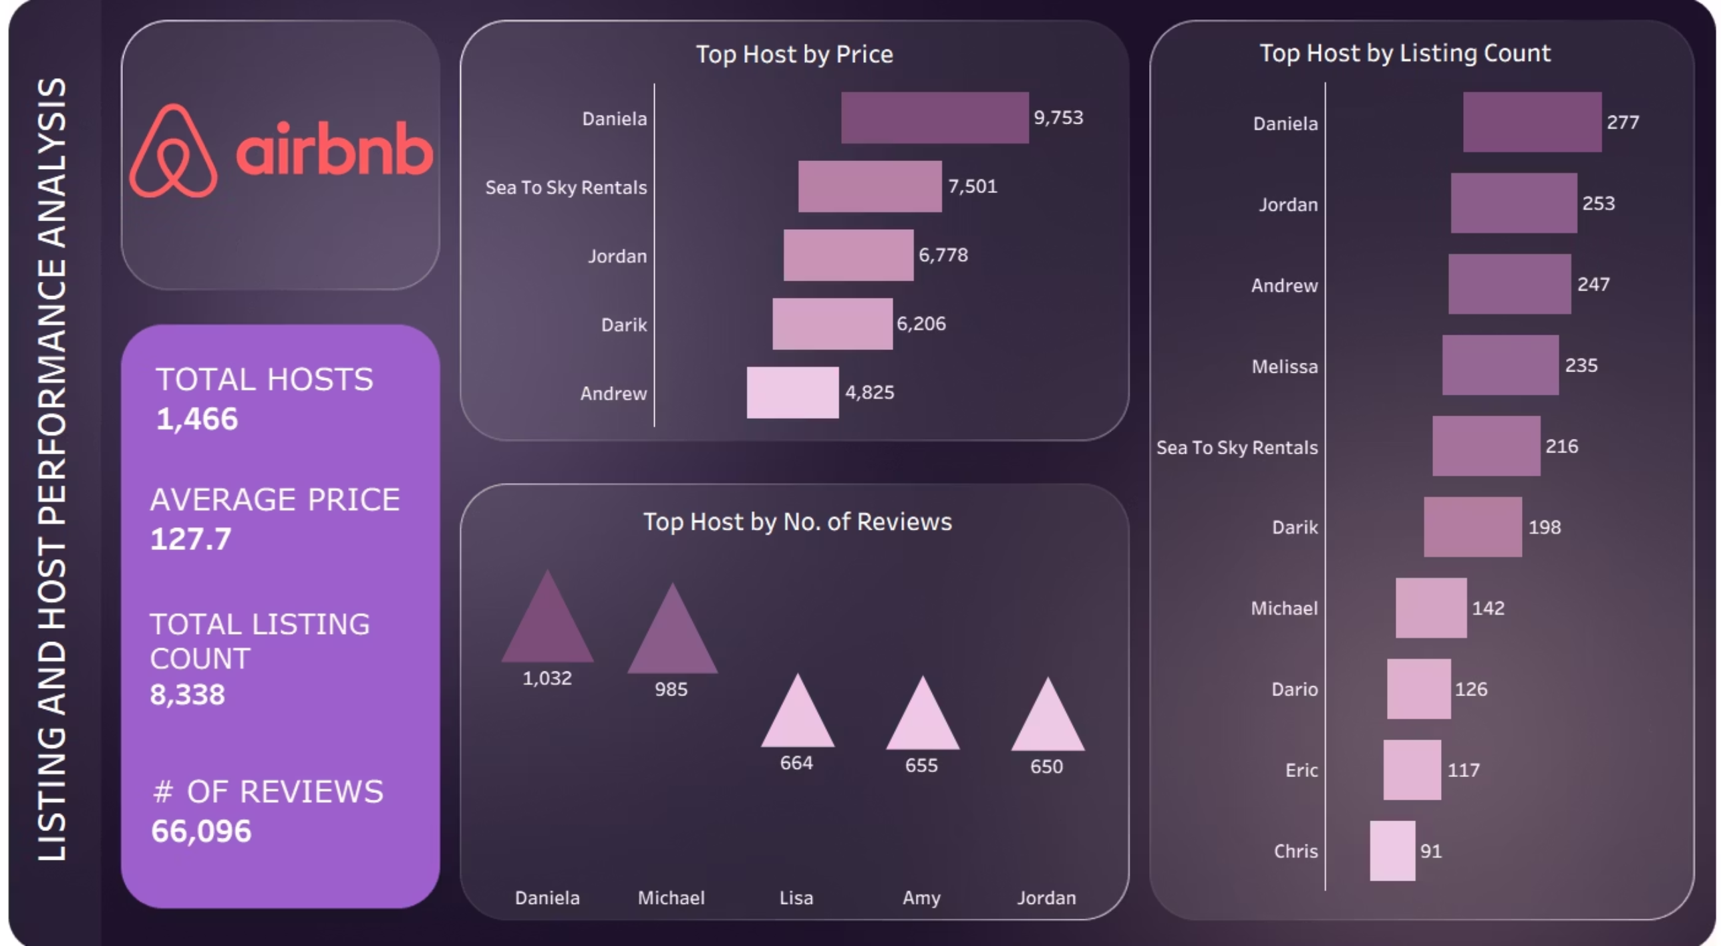

Slide 16
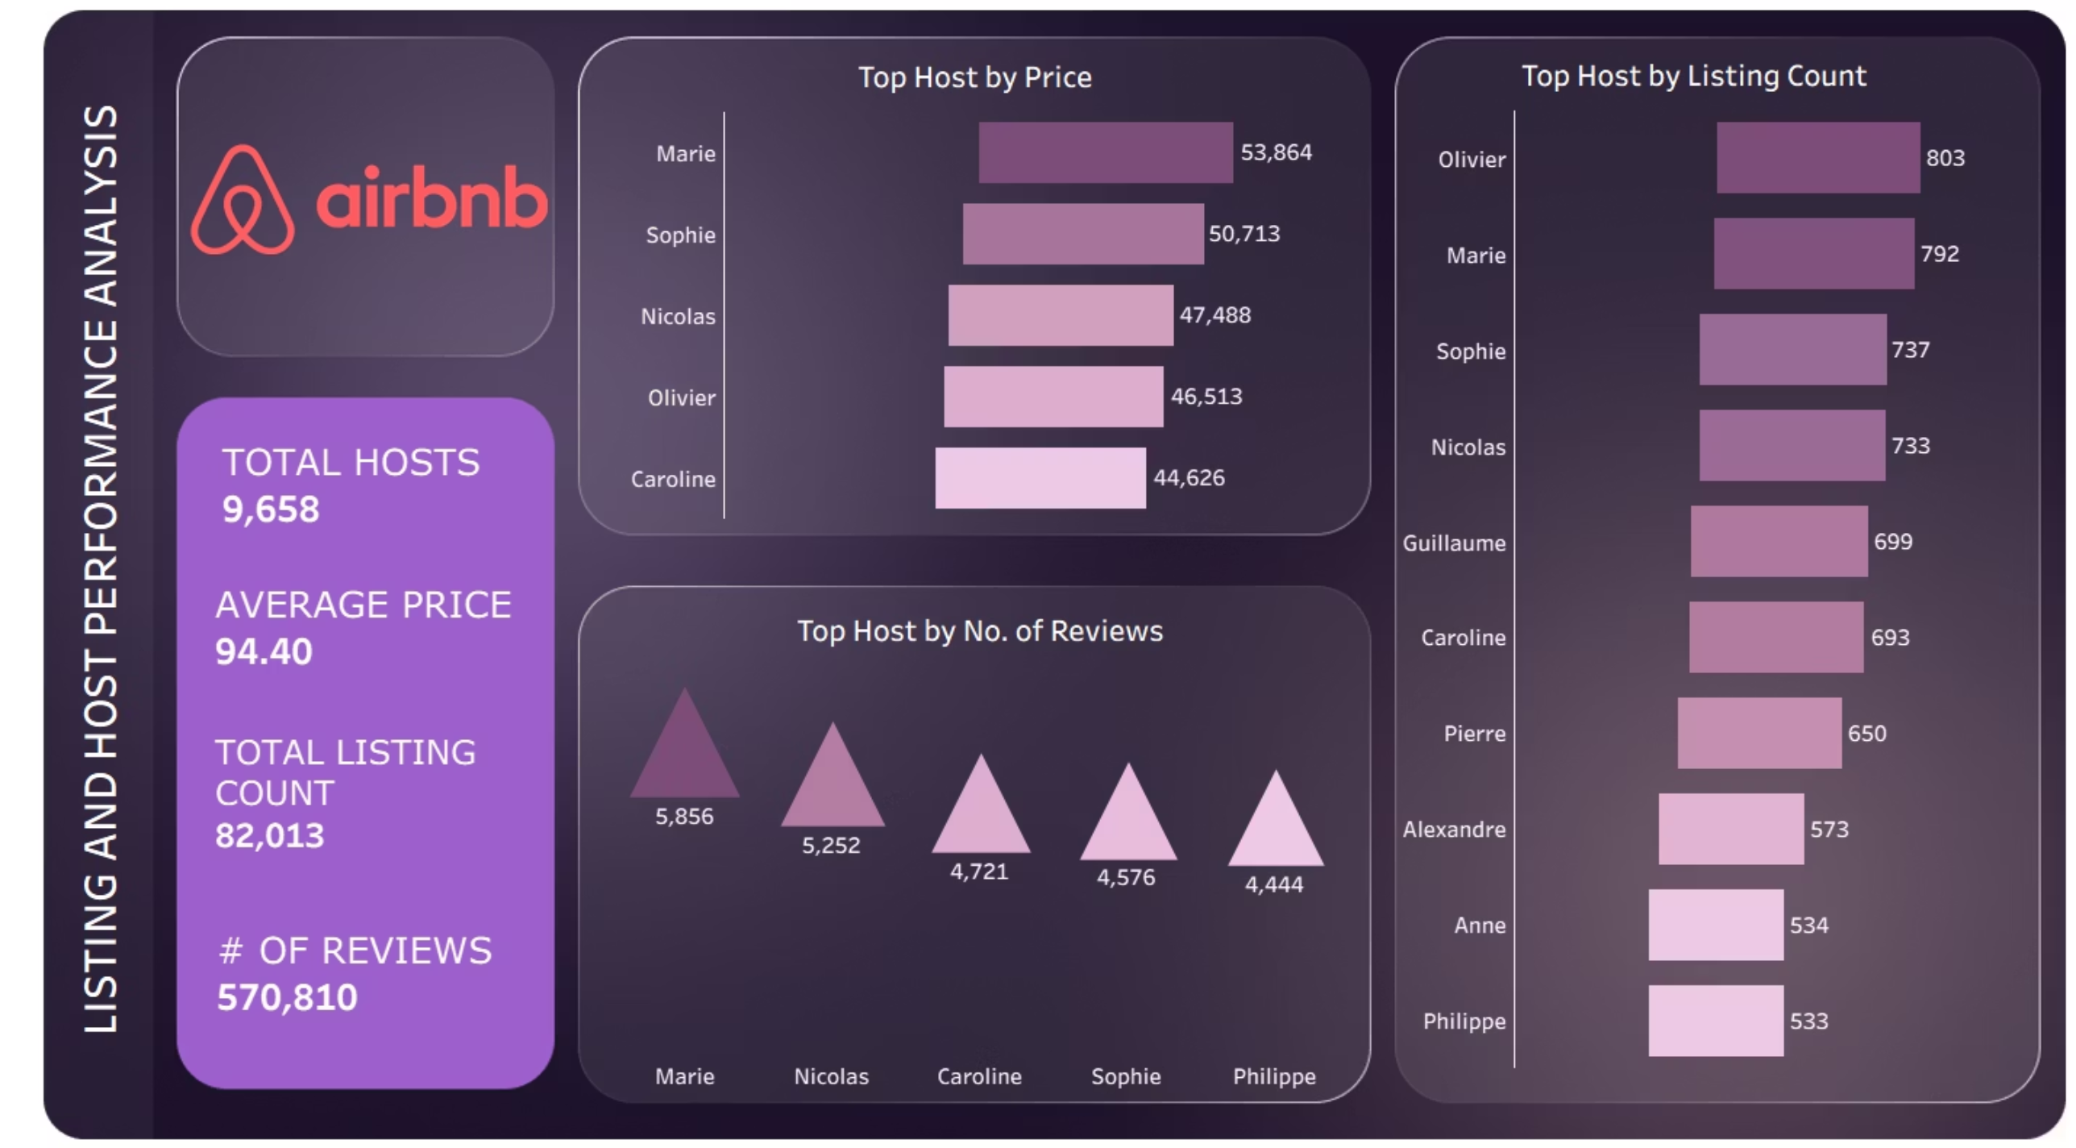

Slide 17
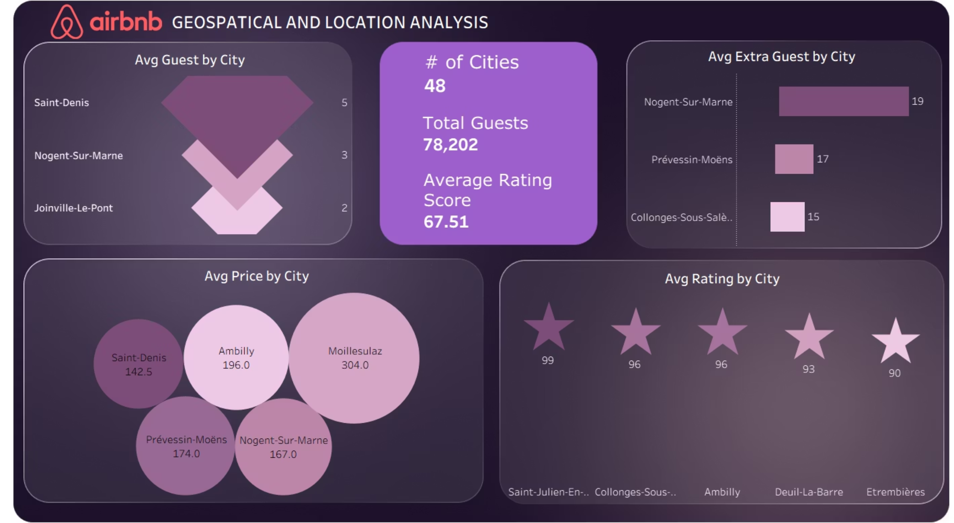

Slide 18
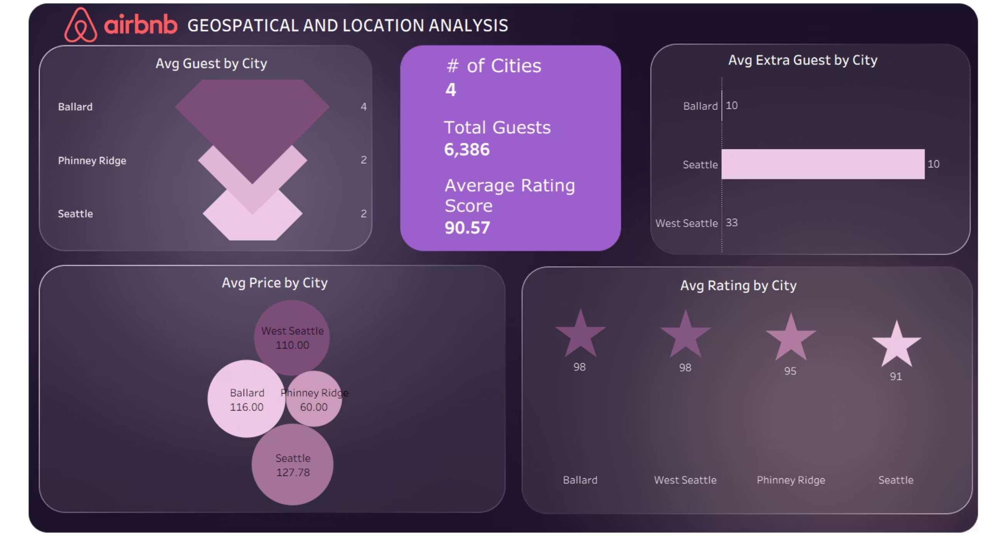

Slide 19
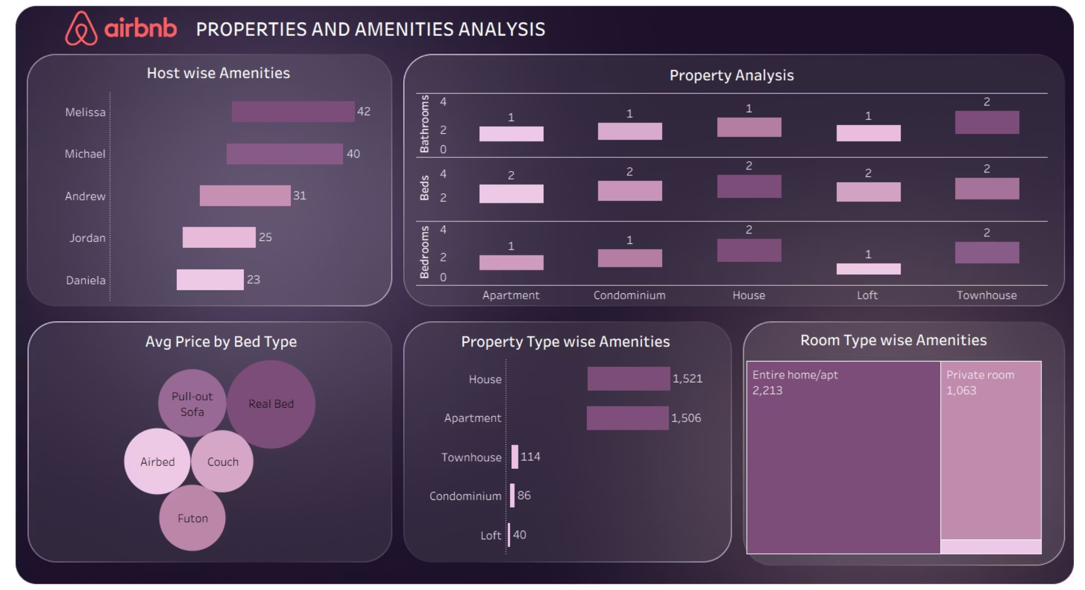

Slide 20
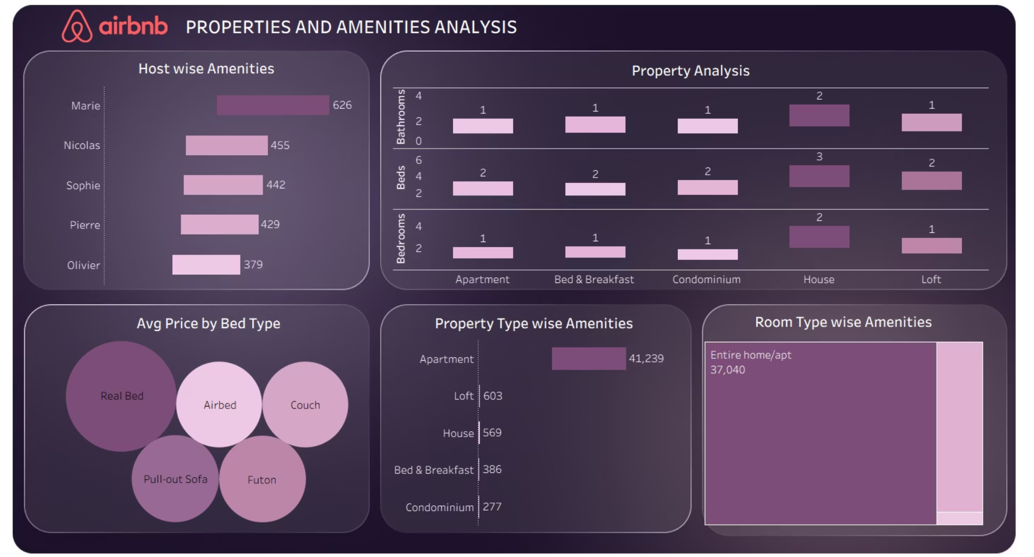

Slide 21
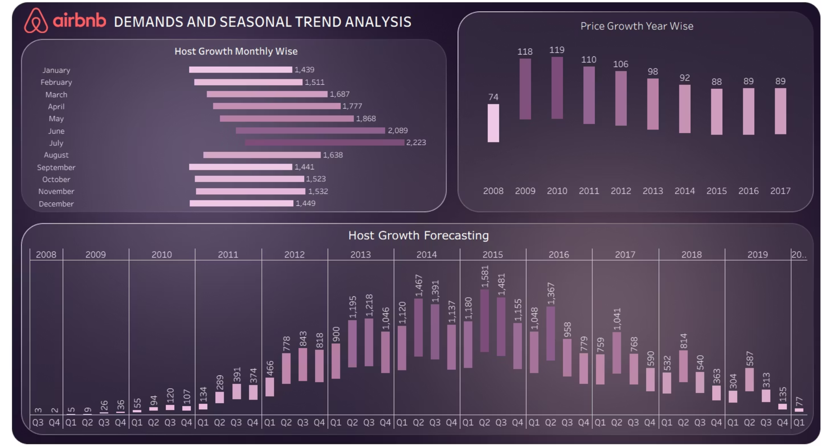

Slide 22
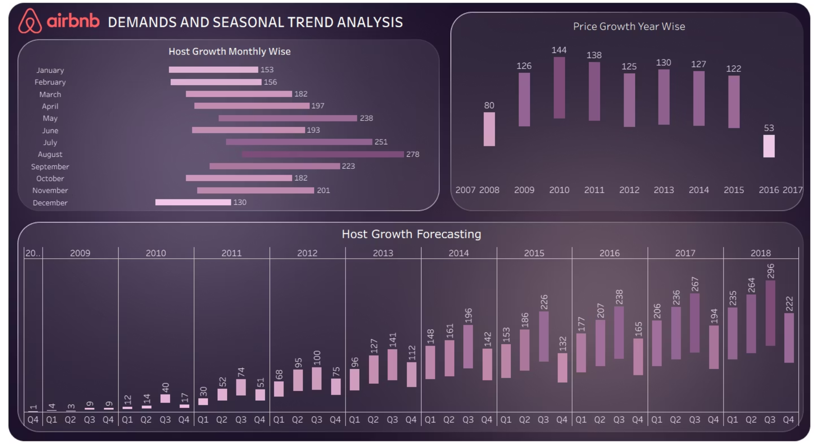

Slide 23
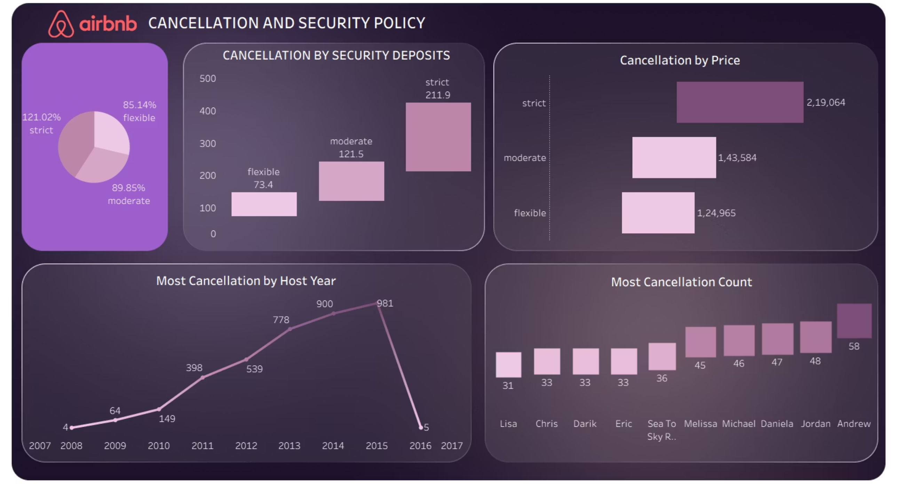

Slide 24
